Slide 1
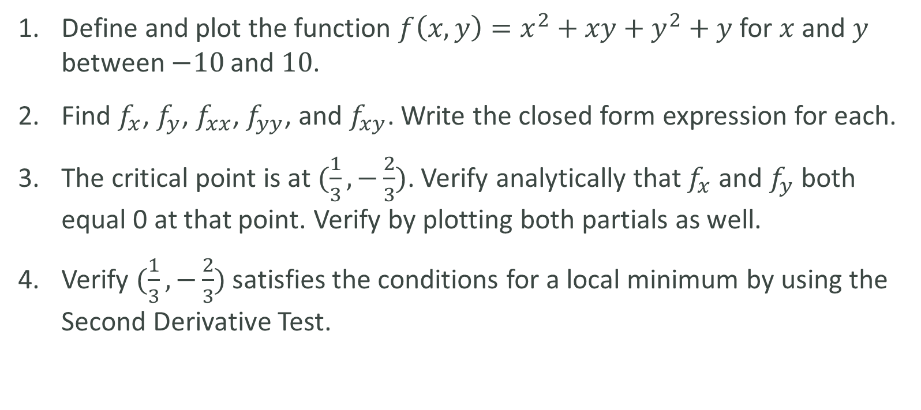
LAB
Define and plot the function $f\left(x,y\right)=x^{2}+xy+y^{2}+y$ for $x$ and $y$ between $−10$and $10$.
Find $f_{x}$, $f_{y}$, $f_{xx}$, $f_{yy}$, and $f_{xy}$. Write the closed form expression for each.
The critical point is at $(\frac{1}{3},−\frac{2}{3})$. Verify analytically that $f_{x}$ and $f_{y}$ both equal 0 at that point. Verify by plotting both partials as well.
Verify $(\frac{1}{3},−\frac{2}{3})$ satisfies the conditions for a local minimum by using the Second Derivative Test.

